Slide 1

Sautech Namibia Services

Slide 2
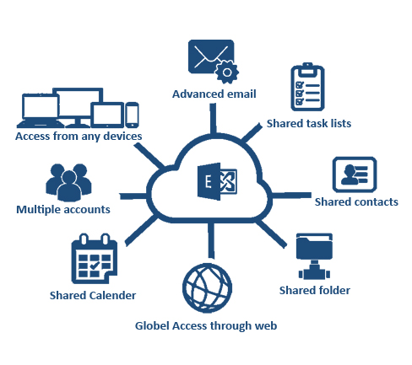
Hosted Microsoft Exchange
Our Hosted Exchange solution is a fully managed Microsoft Exchange 2016/2019 secure and multi-tenanted solution delivered from the cloud. Our Exchange is supported by Microsoft, Checkpoint Security, Hosting Controller and SpamTitan. This environment is in-house supported by Sautech engineers. Sautech was one of the first to offer Hosted Exchange in South Africa
Benefits:
Always ON
Calendar Sharing
Phone/Tablet/Laptop Synchronized email
Backed-up in the Cloud
Work anytime, anywhere: always connected, even if your devices are not with you, Webmail access is available
Up-to-Date: changes made to your email, contacts, and calendars on any device, such as Microsoft Outlook or your smartphone, are kept up to date when accessed via any other device
Work offline when you travel: work on your email, change contacts, and schedule meetings even while disconnected from the internet. .

Slide 3

SentinelOne
Today’s cyber attackers move fast. Fast enough that 1-10-60 has become an obsolete model for effective detection, investigation, and response. Singularity XDR is the only cybersecurity platform empowering modern enterprises to take autonomous, real-time action with greater visibility of their dynamic attack surface and cross-platform security analytics.
SentinelOne is fully managed in house by Sautech.
Three Reasons to Believe:
Best in Class Technology
Industry Recognition & Results
Measurable Performance Advantage
Key features include machine learning, real-time forensics, behavioral attack detection, and automated policy-base responses, along with complete visibility into all activity.

Slide 4

SpamTitan
What is SpamTitan?
SpamTitan Email Security is an advanced email protection solution that blocks phishing, ransomware and malicious email threats. SpamTitan offers protection against malware, spear-phishing, advanced persistent threats (APTs), offering insights into new threats to help mitigate risks. SpamTitan Cloud requires no additional hardware or software.
Features:
Advanced Phishing/Treat/Email Protection
Proven Spam Solution
Email Content Filtering
Security against infected Attachments
Spam Quarantine Reports
Outbound Email Scanning
Whitelisting, Blacklisting & Greylisting

Slide 5

Cyber Security
As the cyber insurance market continues to grow, it’s only natural to discuss its role in the battle against ransomware, which has been a prevalent topic in recent months, and other cyber-attacks. Most discussions highlight its value as a risk mitigation tool and its ability to respond to fast-evolving cyber threats, including ransomware. Recently viewpoints have emerged that cyber insurance has served as an incentive for cyber extortion attacks. The truth is that ransomware attacks occur for one reason only: criminals are succeeding.Cyber insurance can be a valuable tool in the fight against ransomware and other cyber threats. Fulfilling its traditional role, cyber insurance pools the insured that are similarly at risk to spread their potential losses.
Sautech has partnered with IToo Namibia and South Africa to deliver a custom, affordable solution to the market.
The Key requirements for the policy to take effect is:
Management of Infrastructure and Insurance devices to enforce compliance and Standards
SentinelOne Managed XDR
Backups within the Sautech Datacenters, encrypted with Sautech’s Standards and Procedures.
Backups that run daily and at most with a 7-day retention period.

Slide 6
Cyber Insurance
For companies under N$250 million revenue
Annual Turnover | Limit of Indemnity (per claim and in the annual aggregate)
 | *Deductible | N$250 000 | N$500 000 | *Deductible | N$1 000 000
N$0 – N$10 000 000 | 2 500.00 | 1 915.00 | 2 835.00 | 5 000.00 | 4 225.00
N$10 000 001 – N$25 000 000 | 2 500.00 | 2 180.00 | 3 235.00 | 8 500.00 | 4 950.00
N$25 000 001 – N$50 000 000 | 10 000.00 | 2 835.00 | 4 225.00 | 15 000.00 | 6 405.00
N$50 000 001 – N$75 000 000 | 15 000.00 | 3 300.00 | 5 015.00 | 25 000.00 | 7 595.00
N$75 000 001 – N$100 000 000 | 15 000.00 | 3 695.00 | 5 475.00 | 25 000.00 | 8 450.00
N$100 000 001 – N$150 000 000 | 25 000.00 | 4 175.00 | 6 125.00 | 35 000.00 | 9 250.00
N$150 000 001 – N$250 000 000 | 25 000.00 | 5 215.00 | 7 655.00 | 50 000.00 | 11 550.00
Annual premiums reflected
* Each and every claim

Slide 7
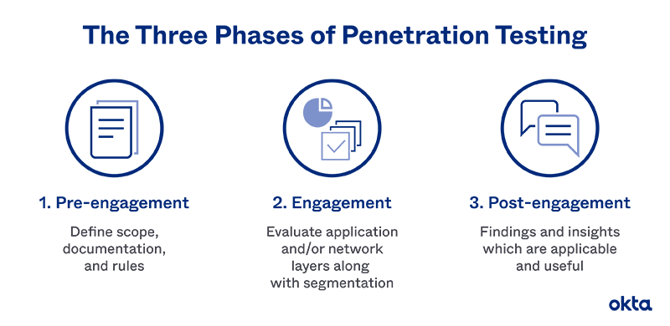
Penetration Testing
A penetration test, also known as a pen test, is a simulated cyber attack against your computer system to check for exploitable vulnerabilities
Penetration Testing Stages
Penetration Testing Method
Planning & Reconnaissance
Scanning
Gaining Access
Maintaining Access
Analysis and WAF Configuration
External Testing
Internal Testing
Blind Testing
Double-blind Testing
Targeted Testing

Slide 8
Virtual Servers
VPS is your own virtual private server. Working with virtual servers is the same as dedicated servers. All access and connectivity is managed by Sautech and access to servers are on the same basis as dedicated infrastructure. VPS gives you computing resources at a lower price when compared to dedicated servers. The flexibility to upgrade resources are easily managed and can be up or down scaled at any time.
Sautech provides the Virtual Infrastructure Hardware and allows you to choose your preferred operating system i.e. Microsoft Windows or Linux Distros.
Why use VPS hosting?
VPS hosting starts from N$250 per month. This enables you to build your own web hosting company, file server, application hosting services and solutions on top of our tiered Dell infrastructure hosted throughout Southern Africa.
Additional services can be installed and configured as tailor made packages. We offer self-managed and managed solutions.

Slide 9
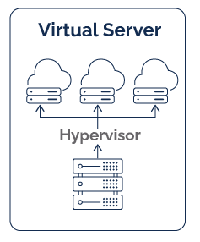
Additional Services:
Windows Server 2022 = N$ 495
vCPU = N$ 125
vRam = N$ 25
vHDD SATA = N$ 0.15
vHDD SDD = N$ 0.30
SentinelOne Server = N$ 50
Veeam Base License = N$ 100
Server Support/ Management = N$ 750
Static IP Address = N$ 130
Hyper-V Rep Na-RSA – 250GB = N$ 350
Hyper-V Rep Na-RSA – 500GB = N$ 500
Hyper-V Rep Na-RSA - 1TB = N$ 700
Hyper-V Rep Na-RSA - 2TB = N$ 1200
Backups per GB = N$ 0.25
Remote Desktop per User = N$ 130
*All prices exclude VAT

Slide 10

Dedicated Server
Why have a physical server?
Powerful performance: Since physical servers are designated to a single client and do not share processors or other components with other users, they deliver greater performance. With physical servers, you won't experience lags even during peak times.
Sautech offers dedicated hardware rental. We have various models and configuration of 1U and 2U Dell servers available either on a fixed term or month to month basis (depending on the specifications). All our servers are dual power supply running from different power feeds for reliable power distribution and uptime.
Dell Server
Entry Level Dell
64GB Memory
2 x Xeon CPU
8TB SATA
N$1500.00
Entry level Server Hosting Namibia N$ 2250
Includes 100GB Bidirectional Bandwidth
*All prices exclude VAT

Slide 11
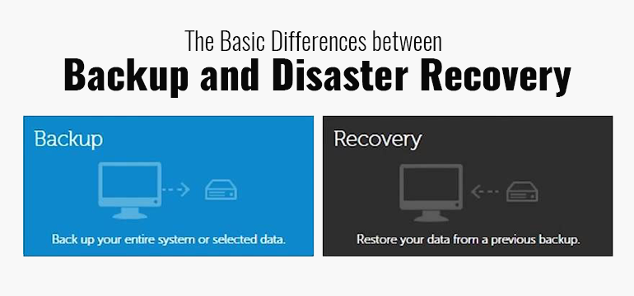
Disaster Recovery & Backups
You might need to restore backup data if you encounter an accidental deletion, database corruption, or problem with a software upgrade. Disaster recovery, on the other hand, refers to the plan and processes for quickly reestablishing access to applications, data, and IT resources after an outage.
The purpose of the backup is to create a copy of data that can be recovered in the event of a primary data failure. Primary data failures can be the result of hardware or software failure, data corruption, or a human-caused event, such as a malicious attack (virus or malware), or accidental deletion of data.
Sautech Operates on either VMWare or Hyper-V and have multiple datacenters as per the design document.
We offer Replication and DR services between South Africa and Namibia.
Backup services can also be hosted within our MPLS Network in either of the above mentioned countries. Our Services are provided using either Veeam or Hyper-V Microsoft Services.
Our storage solution are built upon Synology Hyper-Backup

Slide 12
Reseller Pricing
Virtual Server:
Virtual Serve Base | N$ 250
- per vCPU x2
- per vRam x4
- per vHDD (SATA) per GB x250GB Included
- 20GB Data included
Additional service
Over & Above per GB Bandwidth | N$ 0.15
Physical Server:
Dell Server | N$ 1500
- Dual Quad Core Xeon
- 64GB Ram
- 8TB SATA Disk Space
- 100GB Data Included
Additional service
Over & Above per GB Bandwidth | N$ 0.15
*All prices exclude VAT

Slide 13
Reseller Pricing
Additional Services:
Managed SentinelOne | N$ 50
Server Management | N$ 750
Windows Server Std 2022 | N$ 495
Static IP | N$ 175
Hyper-V Rep Na-RSA - 250 | N$ 350
Hyper-V Rep Na-RSA - 500 | N$ 500
Hyper-V Rep Na-RSA - 1TB | N$ 700
Hyper-V Rep Na-RSA - 2TB | N$ 1200
Veeam Base | N$ 100
Veeam Cloud | N$ 140
Backup Space - Nam | N$ 0,25
Backup Space - RSA | N$ 0,55
Checkpoint firewall IP Secure | N$ 250
Checkpoint Firewall Instance | N$1500
Checkpoint VPN Client | N$ 25
WSUS Management | N$ 15
per vHDD (SSD) per GB | N$ 0.30
Data per GB | N$ 0.15
Per vCPU | N$ 125
Per vRam | N$ 25
Hosted Exchange
Exchange Mailbox - 50GB | N$ 49
Exchange Mailbox - 100GB | N$ 59
Additional Exchange Services
Spamtitan per user | N$ 7
Spamtitan Instance | N$ 500
Mailbox archiving | N$ 40
Hosting Controller Portal | N$ 450
Management per Mailbox | N$ 7
*All prices exclude VAT

Slide 14
Sautech DC Diagrams

